Slide 1


Home
About
Team
Service
Customer Segmentation Analysis Using K-Means Clustering
This project performs Customer Segmentation Analysis using K-Means clustering to group customers based on their Age, Annual Income, and Spending Score. By applying data preprocessing, PCA visualization, and cluster analysis, meaningful customer segments are identified such as high-income low spenders, young high spenders, and average customers. These insights help businesses understand customer behavior, personalize marketing strategies, and improve decision-making for targeted promotions and customer retention.
BY
SDUTHIKA M

Slide 2


Home
About
Team
Service
Dataset Overview (Mall Customers
Dataset)
CustomerID — Unique identifier for each customer
Gender — Male / Female
Age — Customer age in years
Annual Income (k$) — Customer’s yearly income (in thousands)
Spending Score (1–100) — Score assigned by the mall based on purchasing behavior (higher = higher spending)

Slide 3
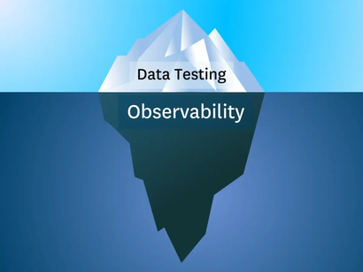
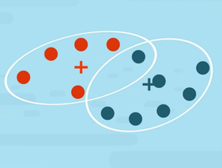

Home
About
Team
Service
The dataset is suitable for EDA because it contains clean, structured numerical and categorical features, and the initial visualizations (scatter plots, pairplots) show clear patterns and separations, indicating that meaningful insights and clusters can be identified.
EDA Summary
1. Data Quality Check
No missing values found
No duplicated records
Dataset is clean and ready for analysis
2. Dataset Overview
Total features: 5 (Gender, Age, Annual Income, Spending Score, CustomerID)
Gender → Categorical
Age, Income, Spending Score → Numerical
3. Gender Distribution
Females slightly higher than males
Mall attracts a balanced mix of male and female customers

Slide 4


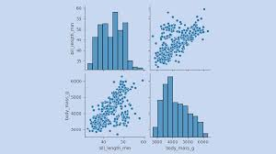
Home
About
Team
Service
EDA Summary
4. Age Distribution
Majority customers are 20–40 years old
Very few customers above 50 years
Indicates mall is more popular among young & middle-aged consumers
5. Annual Income vs. Spending Score
Spending behavior is not directly related to income
Some high-income customers spend less and vice versa
Visible scattered patterns hint towards natural clustering
6. Pairplot Insights
Shows relationships between Age, Income, and Spending Score
Clear separation patterns indicate suitability for K-Means clustering
Confirms presence of different customer behavior groups

Slide 5
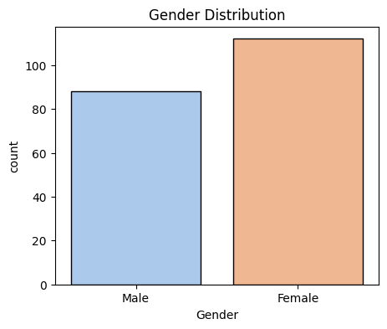
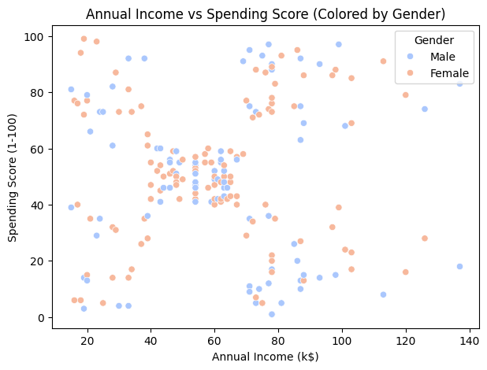
Home
About
Team
Service
EDA

Slide 6
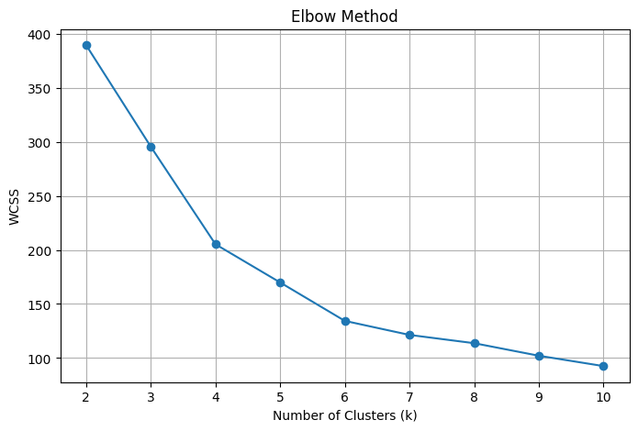
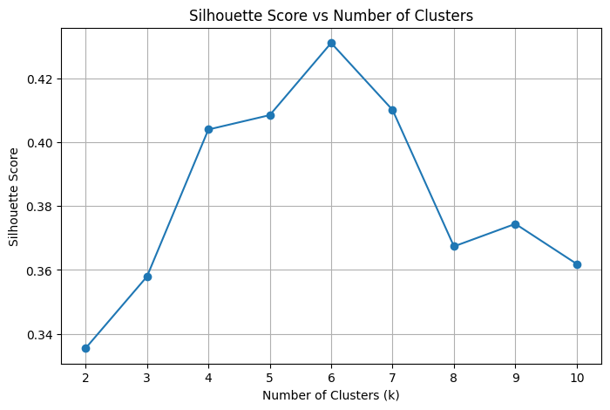
Home
About
Team
Service
Elbow Method & Silhouette Score
The Elbow Method identifies the optimal number of clusters by plotting K vs. WCSS and selecting the point where the curve sharply bends, after which further clusters give minimal improvement.
The Silhouette Score evaluates clustering quality by measuring how well-separated and well-assigned the data points are, with higher values (closer to 1) indicating better cluster formation.

Slide 7

Home
About
Team
Service
Cluster Insights
K-Means clustering groups similar data points into K clusters by assigning points to the nearest centroid and updating the centroids until stable. It helps find natural patterns in customer behavior.

Slide 8

Home
About
Team
Service
Cluster 0 – Conservative Mature Shoppers
Older customers (~56 years), Moderate income, Average spending score
Behavior:
→ Value-focused, stable purchasing patterns, not influenced by trends.
Marketing Strategy:
Promote reliability, comfort-based products
Offer loyalty rewards rather than flashy discounts
Send personalized offers for essentials

Slide 9

Home
About
Team
Service
Cluster 1 – Premium High-Value Young Professionals
Young (~32 years), High income, Very high spending score
Behavior:
→ Luxury-oriented, brand-conscious, ready to pay premium prices.
Marketing Strategy:
Promote premium product lines
VIP membership programs
Early access to new collections
Personalized email campaigns

Slide 10

Home
About
Team
Service
Cluster 2 – Young Trend Seekers / Impulse Buyers
Very young (~25), Low income, High spending score
Behavior:
→ Impulsive, loves new arrivals, spends more than income level suggests.
Marketing Strategy:
Frequent discounts
Instagram/social media ads
Flash sale notifications
Gamified rewards

Slide 11

Home
About
Team
Service
Cluster 3 – Practical Young Earners
Young (~26), Middle income, Low to moderate spending
Behavior:
→ Price-sensitive but willing to spend occasionally.
Marketing Strategy:
Combo offers
Wallet cashback
Student-oriented promotion

Slide 12

Home
About
Team
Service
Cluster 4 – Wealthy Minimal Spenders (High Income but Low Interest)
Middle-aged (~44), High income (~90k), Very low spending score (~18)
Behavior:
→ They can spend but choose not to.
→ Low engagement customers.
Marketing Strategy:
Exclusive invitations
Personalized recommendations
Highlight product quality and long-term value

Slide 13

Home
About
Team
Service
Cluster 5 – Low Income Low Spend Customers
Older (~45), Low income (~26k), Very low spending
Behavior:
→ Mostly essential buyers, cost-conscious.
Marketing Strategy:
Budget-friendly products
Seasonal discounts
SMS-based offers

Slide 14
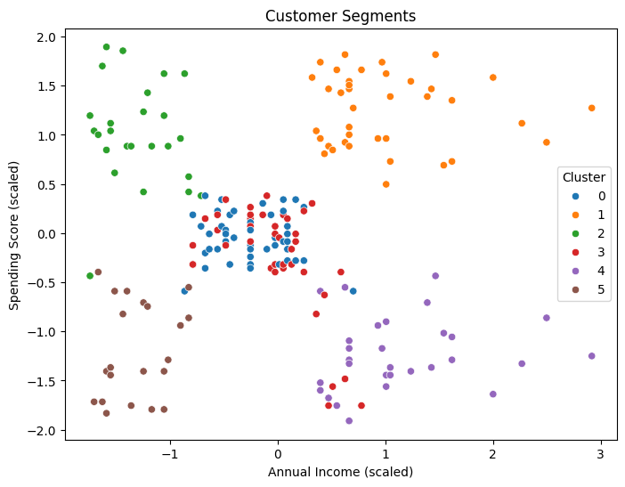
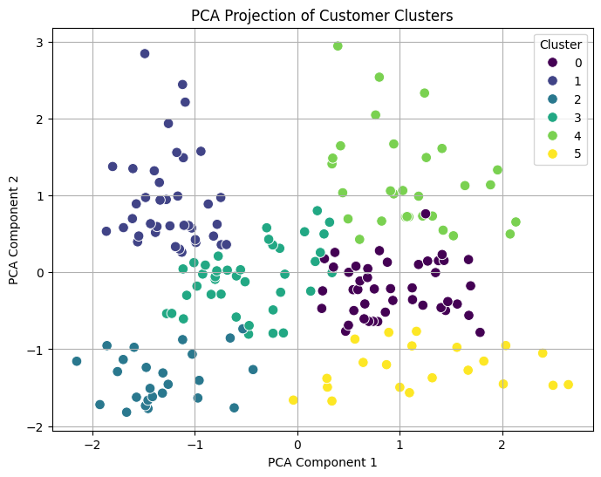
Home
About
Team
Service
PCA
Principal Component Analysis (PCA) is a dimensionality reduction technique that transforms high-dimensional data into a smaller number of components while preserving the maximum variance, making it easier to visualize clusters in 2D or 3D.

Slide 15
THANK YOU!

